Slide 1
Risk Identification and Prediction for Long COVID
Mid-Project Assessment
Emma Jin, Elliot Kim, Victoria Song
CS 66 (Fall 21)

Slide 2
The Long COVID Problem
Long COVID: persistence of symptoms post-COVID-19
Symptoms: Headaches, Fatigue, Cough/Shortness of breath, Anxiety, Heart problems, Muscle aches, Dizziness
Affected population: subpopulation of COVID-19 patients who retain COVID symptoms
Goals: identify risk factors of Long COVID and predict likelihoods that a patient would suffer from Long COVID
Dataset: COVID-19 Fall 2020 & Winter 2021 Community Supplement from MCBS (Medicare Current Beneficiary Survey)
Notes:
ELLIOT
You may have heard of Long COVID already, but Long COVID is a phenomenon where patients who have recovered from COVID-19 still experience lingering effects of COVID. And these can range from dizziness to fatigue to heart problems.
Although many COVID patients who recover from the disease are able to do so fully, there exists a subpopulation of patients who retain COVID symptoms. These symptoms can range from headaches to shortness of breath to anxiety to heart problems.
We want to identify the risk factors for Long COVID and predict the likelihood that a patient would suffer from Long COVID.

Slide 3
Overall Plan
Find usable dataset
Pre-process data
Identify models to test
Train, test, tune, validate models
Select highest-performing model and identify risk factors
Construct ranking system of Long COVID risk factors
Repeat with Long COVID patient subgroups by lasting symptom
Notes:
ELLIOT
Our overall plan has been to
First, find a usable dataset.
Then pre-process that data, which includes getting rid of nuisance data.
We wanted to try various models and train, test, tune, and validate them.
And then use the best-performing models to identify which features in the data might be risk factors correlated with Long COVID.
There are a variety of different things that can be done

Slide 4
Progress
Data pre-processing: Removed nuisance features (interview IDs), mapped feature code labels to human-readable language
Training & testing: Compared Logistic Regression, Decision Tree, Random Forest, SVM (RBF), Naive Bayes (Complement)
Tuning & validation: Performed grid search, k-fold validation
Selected best model: RandomForest with max_features = 0.5, min_samples_leaf = 1 (accuracy of 0.723)
Examine the feature importance and risk factors of the model chosen
Notes:
EMMA
Joined the two datasets, removed nuisance features, mapped feature labels to human-readable language
Built and compared the performance of 5 models
Tuned all 5 models with grid search and k-fold validation
Selected best model, which turns out to be the Random Forest Classifier with parameters … This eventually gave us an accuracy of 72%.
Afterwards, we plotted the feature importances of the Random Forest Classifer to identify the risk factors for long COVID

Slide 5
Table: Average Test Scores of Different Models
 | Original Model | Tuned Model
Logistic Regression | 0.65651 | 0.68258
Decision Tree | 0.66205 | 0.60044
Random Forest | 0.68698 | 0.71697
SVM | 0.71191 | 0.67591
Naive Bayes (ComplementNB) | 0.57618 | 0.59934
Notes:
EMMA
Here is a table that contains the performance scores for the 5 different models we tested. As you can see, the highest accuracy is achieved by the Tuned Random Forest model, so this is what we ended up using for our risk factor identification

Slide 6
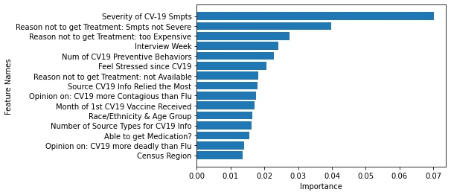
Risk Factors Importance Using Random Forest
Notes:
VICTORIA

Slide 7
Next Steps
Analyze and discuss prominent risk factors
Construct ranking system of Long COVID risk factors
Repeat with Long COVID patient subgroups by lasting symptom
Notes:
VICTORIA

Slide 8
Thank you!

